Slide 1

REALTY HUB
Aazib abdullah 22i-1031
Amir akbar 22i-1112
Rayyan Khan 22i-1002

Slide 2

INTRODUCTION
RealtyHub is an integrated platform developed to streamline the management of real estate operations. It consolidates key functionalities such as property listings, client interactions, and transaction processing into a single, user-friendly interface. By addressing the inefficiencies of fragmented systems, RealtyHub aims to provide a cohesive solution that enhances operational efficiency for real estate professionals and property managers.

Slide 3
PROBLEM STATEMENT:
"Finding, buying, renting, or selling property can be time-consuming and risky due to fraudulent listings, lack of transparency, and the hassle of document verification. Users need a reliable platform that simplifies property transactions, ensures trust, and provides seamless interactions between buyers and sellers."

Slide 4
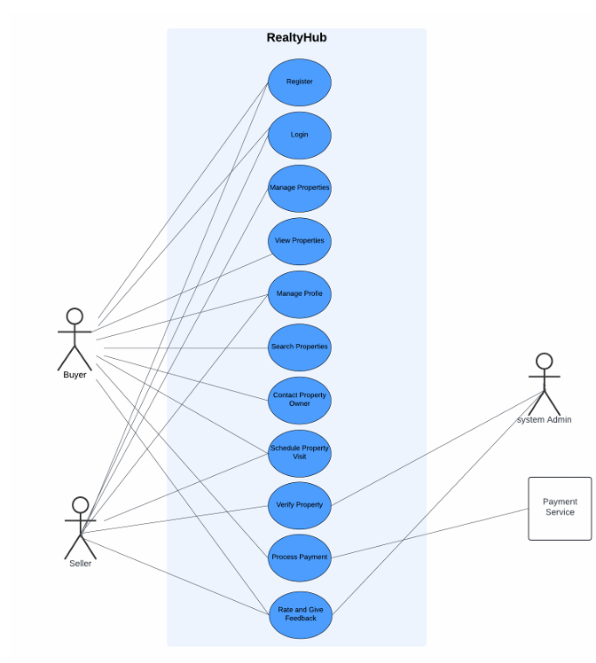
USE CASE DIAGRAM

Slide 5
USE CASE DIVISION
Aazib
Amir Akbar
Rayyan
Register
Login
Manage Properties
View Properties
Search Properties
Contact Property Owner
Schedule Property Visit
Verify Property
Process Payment
Rate and Give Feedback

Slide 6
Use Case Name: Search Properties
Scope: RealtyHub
Level: User Goal
Primary Actor: Buyer
Stakeholders and Interests:
-Buyer – wants to view compatible properties
-Seller – wants to sell or rent out their property
Preconditions:
-Buyer is logged in
-Properties matching search criteria exist
Postconditions:
-System displays properties that fit the Buyer’s criteria
Main Success Scenario:
1. Buyer chooses to search properties
2. System prompts Buyer to enter search criteria
3. Buyer enters criteria
4. System displays properties that match the entered criteria
Extensions:
4a. No properties match the entered criteria
SEARCH PROPERTIES
EXTENDED USE CASE

Slide 7
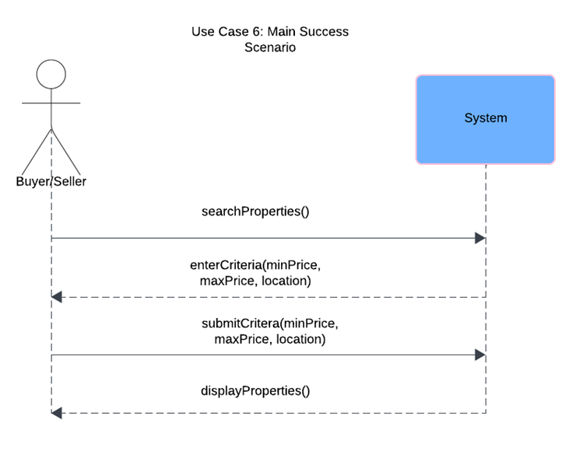
SEARCH PROPERTIES
SYSTEM SEQUENCE DIAGRAM

Slide 8
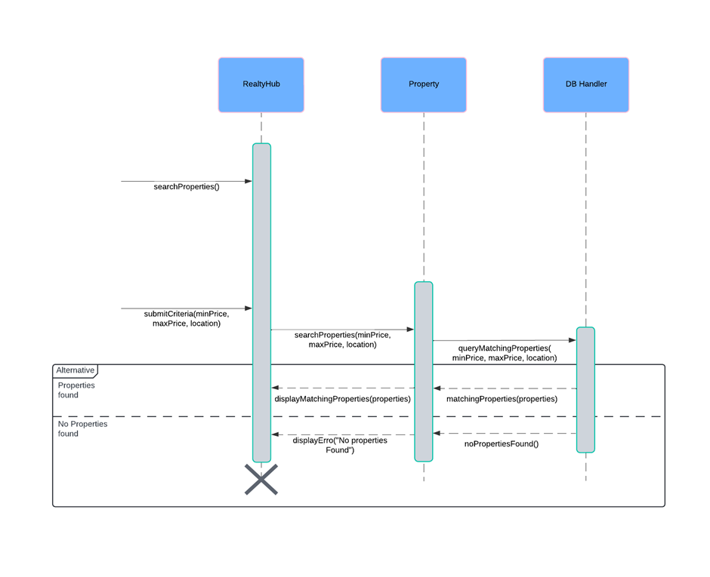
SEARCH PROPERTIES
SEQUENCE DIAGRAM

Slide 9
SEARCH PROPERTIES
SEQUENCE DIAGRAM

Slide 10
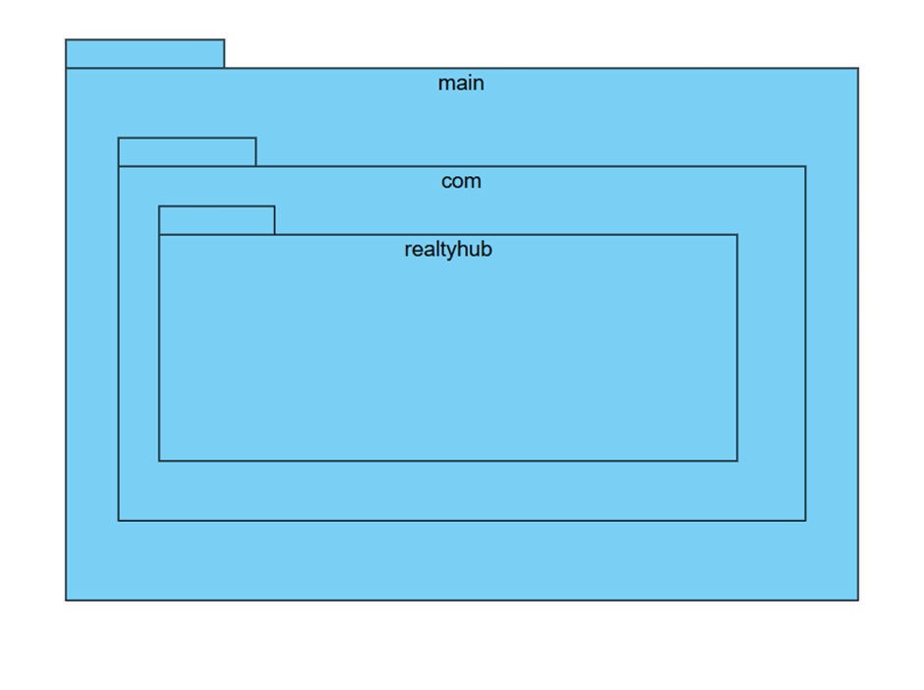
REALTYHUB
PACKAGE DIAGRAM

Slide 11
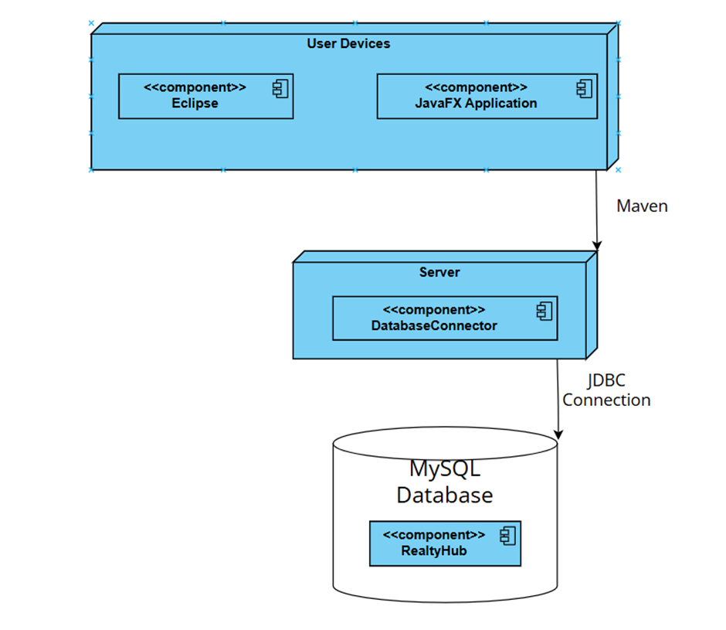
REALTYHUB
DEPLOYMENT DIAGRAM

